Slide 1
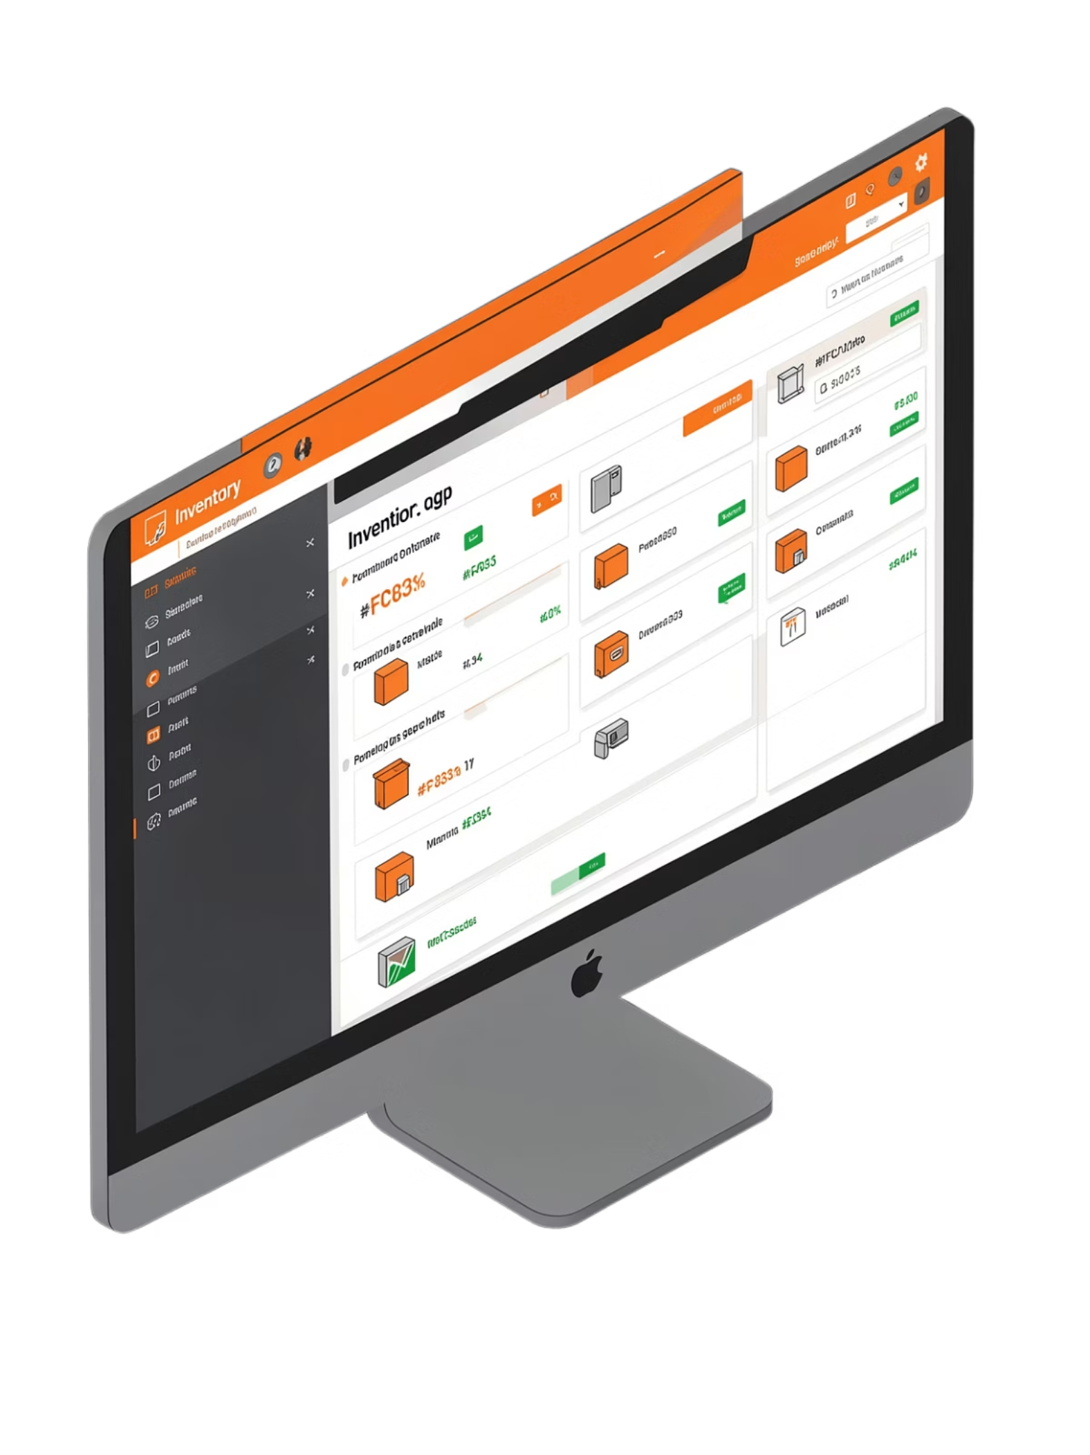
In-flow Inventory Software
Sales Order Module
Presented By: Samruddhi Jagtap | Shubham Dhone | Om Deshmukh | Suraj Patil

Slide 2
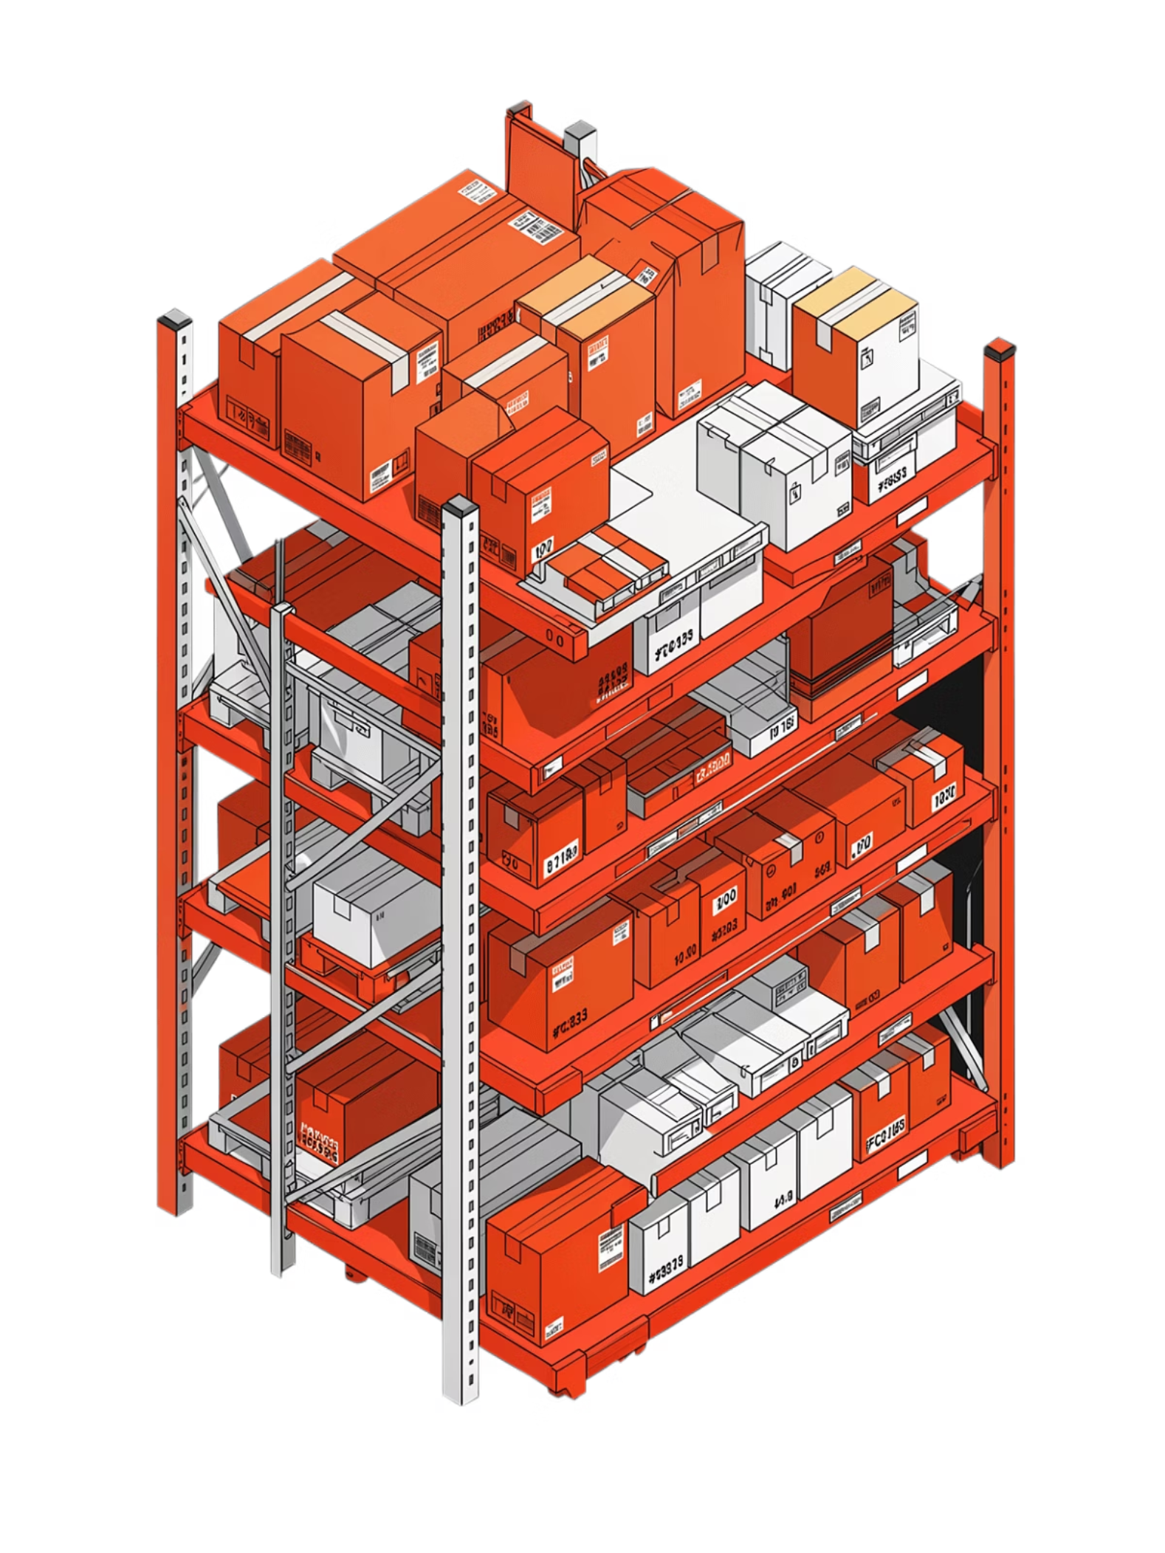
Explanation Of Project
InFlow Inventory Software
InFlow Inventory is inventory management software that helps businesses manage stock, sales, purchases, customers, and suppliers in one place.
Key Benefits
Helps Businesses
Tracks inventory in real time
Reduces manual work and errors
Automates orders and invoicing
Saves time across daily operations
Monitor available stock
Record customer orders
Manage suppliers and purchases
Track deliveries and generate invoices

Slide 3

Roles and Responsibilities
Project: Manual Testing of InFlow Inventory Software | Module: Sales Order
TEAM LEADER
TEAM MEMBERS
Requirement Analysis
Scenario Distribution
Team Coordination
Test Case Review
Progress Monitoring
Requirement Analysis
Test Case Preparation
Test Execution
Bug Reporting
Documentation

Slide 4
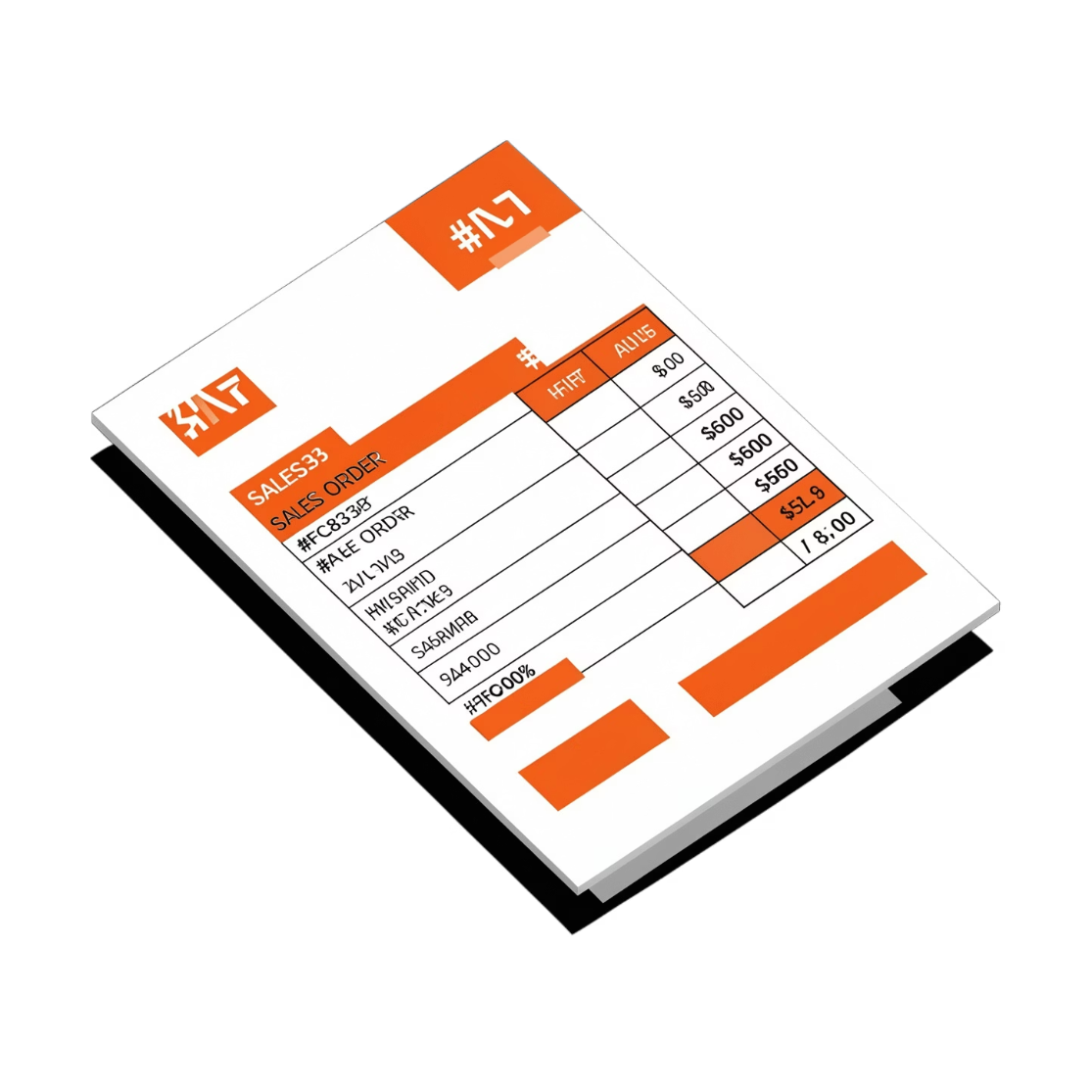

Explanation of Modules
Sales Order Module
A Sales Order is a document created when a customer places an order to buy products from a company.
It contains all the details about the customer's order, such as:
Customer information
Products ordered
Quantity
Price
Taxes
Shipping details
Total amount
In simple words: "A Sales Order is a record of what the customer wants to purchase."

Slide 5
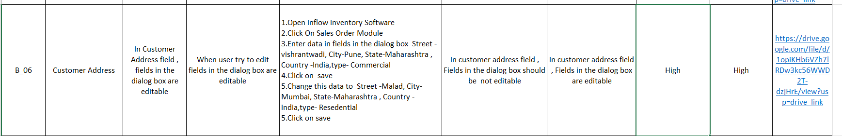
Defects Found
BUG B_004
HIGH SEVERITY & HIGH PRIORITY
1. High Severity and High Priority
Test Scenario: The fields in the dialog box should be not editable

Slide 6
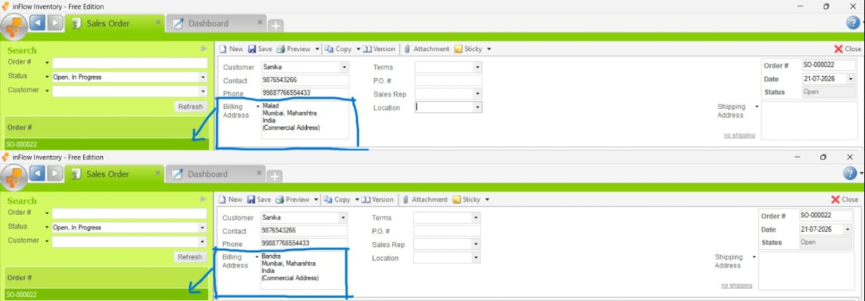
Screenshot :

Slide 7
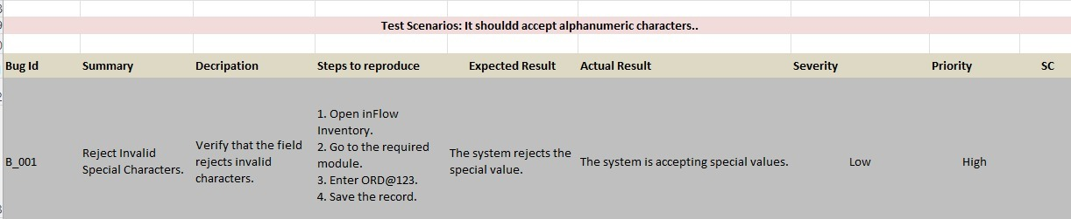
Defects Found
BUG B_001
LOW SEVERITY & HIGH PRIORITY
2. Low Severity and High Priority
Test Scenario: It should accept alphanumeric characters.

Slide 8
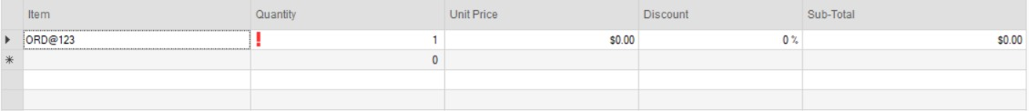

Slide 9
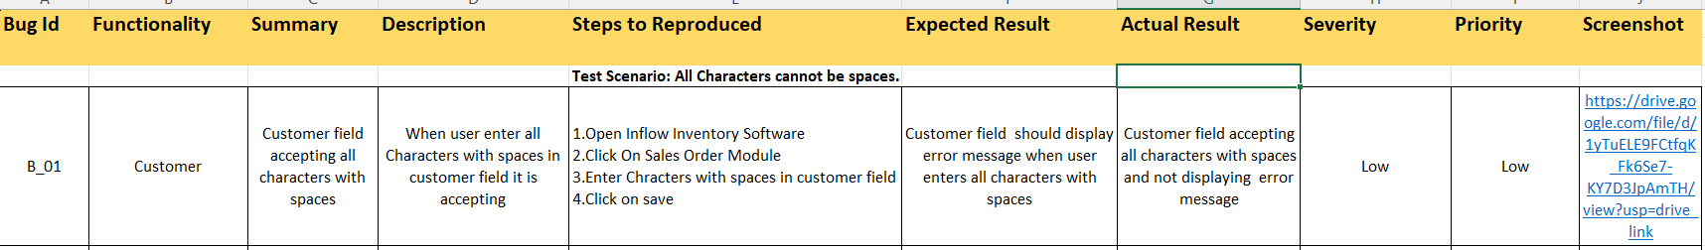

Defects Found
BUG B_01
3. Low Severity and Low Priority
Test Scenario: All Characters cannot be spaces.

Slide 10
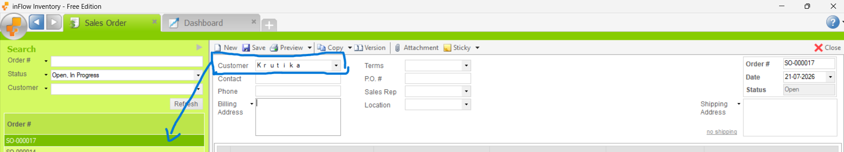
Screenshot:

Slide 11
Defect Summary
Overview of all defects identified during manual testing of the Sales Order Module.
B_004
B_001
B_01
High Severity / High Priority
No specific ID column for product — only Item Name or Item Code can be added.
Low Severity / High Priority
System accepts special characters (e.g. ORD@123) instead of rejecting them.
Low Severity / Low Priority
Customer field accepts all characters with spaces without displaying an error message.

Slide 12

Challenges
Understanding the Sales Order Module
Difficulty in Task Management
Communication Gaps Between Team Members
Test Case Review Issues
Managing Testing Time
Defect Report Review Issues
Maintaining Documentation Quality

Slide 13





Experience
Team Leadership
Practical Knowledge
Team Coordination
Defect Management
Worked as a Team Leader for the Manual Testing project of the InFlow Inventory – Sales Order Module.
Gained practical experience in understanding software requirements and dividing a module into different functionalities.
Improved team coordination and communication. Experienced in reviewing test cases and assigning tasks effectively.
Learned how to identify, analyze, and report defects with proper details throughout the testing lifecycle.
Confidence & Growth
Developed confidence in leading a team and delivering quality work. Learned the importance of collaboration, time management, and documentation.

Slide 14

Vote Of Thanks
We sincerely thank everyone who supported and guided us throughout this project. Your encouragement and mentorship made this journey truly rewarding.
Our Team
Samruddhi Jagtap | Shubham Dhone | Om Deshmukh | Suraj Patil
Project
Manual Testing of InFlow Inventory Software – Sales Order Module

